Slide 1
Designing an AI-Enhanced Database Ecosystem for a Movie Rental Company

Slide 2


Agenda
Movie Rental Company Analysis
Database Selection and Connectivity
Database Security and Administration
AI Database Integration and Optimization
Data Analytics and Business Intelligence

Slide 3

Movie Rental Company Analysis

Slide 4

Overview and Problem Statement
The Movie Rental Company has a vast collection of movies and users of different demographics with changing preferences.
The Movie Rental Company wants to implement a modern and AI driven data management ecosystem to create a personalized movie recommendation system in an effort to increase customer retention on the platform.
The goal is to store data using the appropriate database management system type so it can be properly used by AI algorithms to make better business decisions, provide insight into inventory, and provide an overall better user experience.
Notes:
This slide is an overview of the company.

Slide 5
Specific Problem Areas
Vast Movie Library: The rental company has a wide variety of movies new and old that is constantly being added to and updated. This data needs to be organized efficiently so it can be accessed for user recommendations.
Growing Customer Information: The rental company has many users of its platform and this is constantly growing. The data includes demographics information along with information about their memberships and rental history.
Changing Customer Preferences: The company hopes to stay on top of trends and changing customer preferences by better utilizing the data the company has on its users and movie library to have more informed business decisions on things like content and inventory management.
Notes:
This slide discusses specific problem areas that the company is experiencing and breaks them down into three areas.

Slide 6

AI Integration
The Company hopes to integrate AI into its Database Management in four key ways.
Automated Data Management: Company wants to automatically keep and make changes to records and categorize their vast movie backlog.
Personal Customer experiences: create algorithms to provide analysis on rental behavior to have recommendations based on the specific user.
Inventory Optimization: Company wants to use AI to predict preferences and trends to help ensure that the movies people want are always available.
Business Intelligence: Company wants to look at historical data to improve its targeted marketing and decision making.
Notes:
This slide talks about the AI integration the company is looking to achieve with its new database ecosystem.

Slide 7

Database Selection and Connectivity

Slide 8
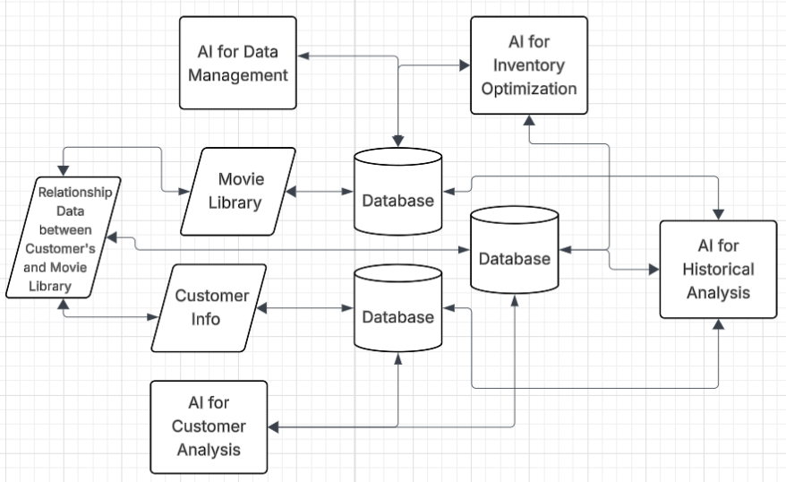
Visualizing the Problem
Notes:
This slide is a diagram of the high level overview of what the company needs for its databases.

Slide 9

Vast Movie Library Database
Vast Movie Library: The rental company has a wide variety of movies new and old that is constantly being added to and updated. This data needs to be organized efficiently so it can be accessed for user recommendations.
The movie library has so many different data types and structures.
It also is constantly changing and updating as new items get added.
Because of the varied data structure and schema changes a key value nosql database will work best for this section of the data.
This flexible schema will allow us to continually update the database with new movies and genres without causing too much trouble.
This also allows us to index the library better for faster queries which will be critical for searching, recommending, and AI integration.
(How to Choose the Right Database for Your Application?, 2020)
Notes:
This slide goes over the selection of a NOSQL database for the movie library.

Slide 10
Customer Information Data
Growing Customer Information: The rental company has many users of its platform and this is constantly growing. The data includes demographics information along with information about their memberships and rental history.
Customer data is much more static than the library of movie data.
Additional data integrity is needed for this for the actual transactions of renting movies.
We have well defined relationships between customers, rentals, and payments.
Because of these reasons a traditional relational database will be used still for this portion of the data.
This also helps keep costs and complexity down as its less data to migrate into a new system.
(ByteByteGo, 2022)
Notes:
This slide goes over the selection of a traditional relational database for the customer information.

Slide 11
Customer Preferences and Relationships
Changing Customer Preferences: The company hopes to stay on top of trends and changing customer preferences by better utilizing the data the company has on its users and movie library to have more informed business decisions on things like content and inventory management.
Because of the volume of users and movies, it can be hard to create queries and model relationships effectively with a traditional database.
this would require the creation of many tables with different primary and foreign keys, and even then, there is work needed to understand the relationships fully.
For this portion of data, we will be using a graph database to visualize and simplify the modeling of these relationships.
Will help us identify similar customers who rented the same movie to power our personalized recommendations.
(Graph Database Concepts - Getting Started, n.d.)
Notes:
This slide goes over the selection of a graph database for the customer preferences and relationship information.

Slide 12
Improving the User Experience
On top of our three “main” data portions, we want to improve the user experience.
Since we are migrating our movie data to a nosql database, we will need an improved and efficient way for customers to interact with it.
Because of this the company should also implement a search engine database to be integrated with the nosql database.
This allows for full text search capabilities and can be built with similar indexes to the nosql database for fast retrieval of movies.
(What Is a Search-Engine Database?, n.d.)
Notes:
This slide goes over the addition of a search engine database to further improve the movie rental app.

Slide 13
Historical and real time analysis of trends
Now that we have a way to simply model the relationships between the data, we need a way to easily analyze trends in rental patterns and customer behavior.
To do this, the company should implement a time series database.
This allows easy visualization of temporal data, so you can see things like the last time a customer rented a movie, or if a movie is being rented more frequently than it used to.
This will help the company keep on top of trends and make more informed business decisions.
(Time Series Database (TSDB) Guide, n.d.)
Notes:
This slide goes over the selection of a time series database for analysis and real time reporting.

Slide 14
Bringing the whole thing together
Using AWS, we can host all of these databases in the same cloud network.
This simplifies the connection process as amazon services have native integration with each other.
AWS DynamoDB for the Nosql dB, AWS RDS for the relational DB, AWS Neptune for the graph DB, AWS Timestream for the time series DB, AWS Elasticsearch for the search engine db.
We then can utilize Amazon’s native Identity Access Management tools as well to provide set credentials to our AI tools.
With IAM, we can set the permissions for the algorithms so they can only interact and change certain things.
We will be following the principle of least access for this.
Notes:
This slide discusses hosting the database ecosystem on AWS for simplicity and native integration.

Slide 15
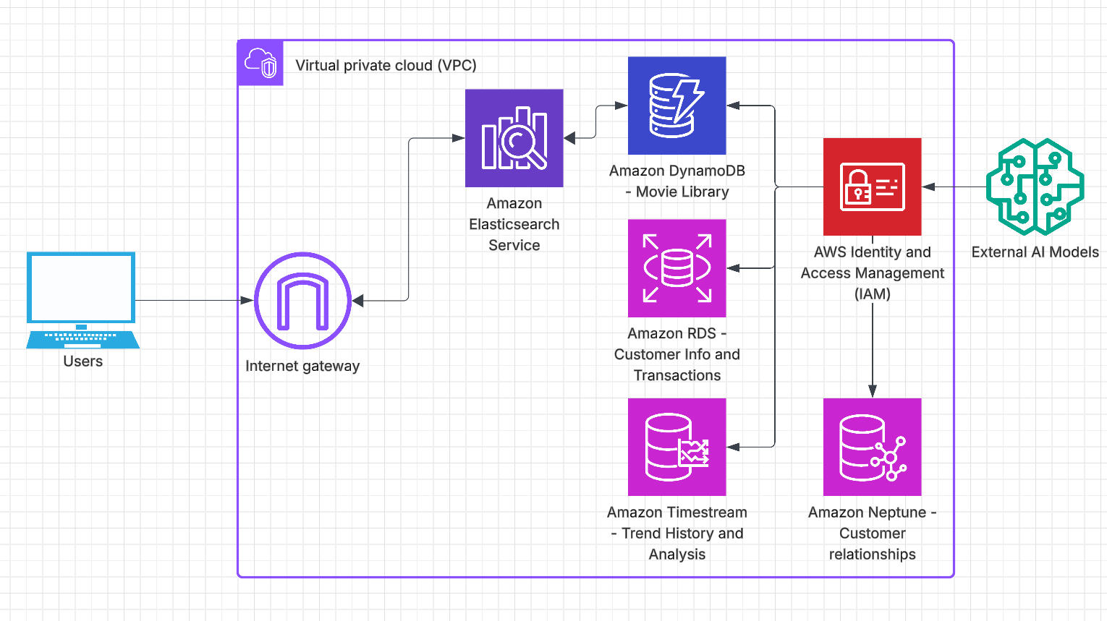
Bringing the whole thing together
Notes:
This slide provides a visual of the ecosystem as discussed so far.

Slide 16
Database Security and Administration

Slide 17
Database security
We will be adding security to our ecosystem in 5 key ways to ensure we have total security coverage and minimizing the chance for leaks or theft.
Private subnets – we can store the actual data in a private subnet in our cloud network away from public access.
Identity Access Management – we can use access controls and Multifactor authentication for user access as well as giving granular control to our AI models.
Encryption – we will use secure socket layer and transit socket layer protocols to encrypt the data at rest and in transit.
Security groups – we can further secure our network by creating security groups to direct traffic and create specific inbound and outbound rules for our databases.
Tokenization – we can use the concept of tokenization to replace sensitive customer data (ie. Credit card info) in the database so even if data is queried it needs to be decrypted to see that information.
(IBM, 2021)
Notes:
This slide discusses the security protocols that we will put into place.

Slide 18
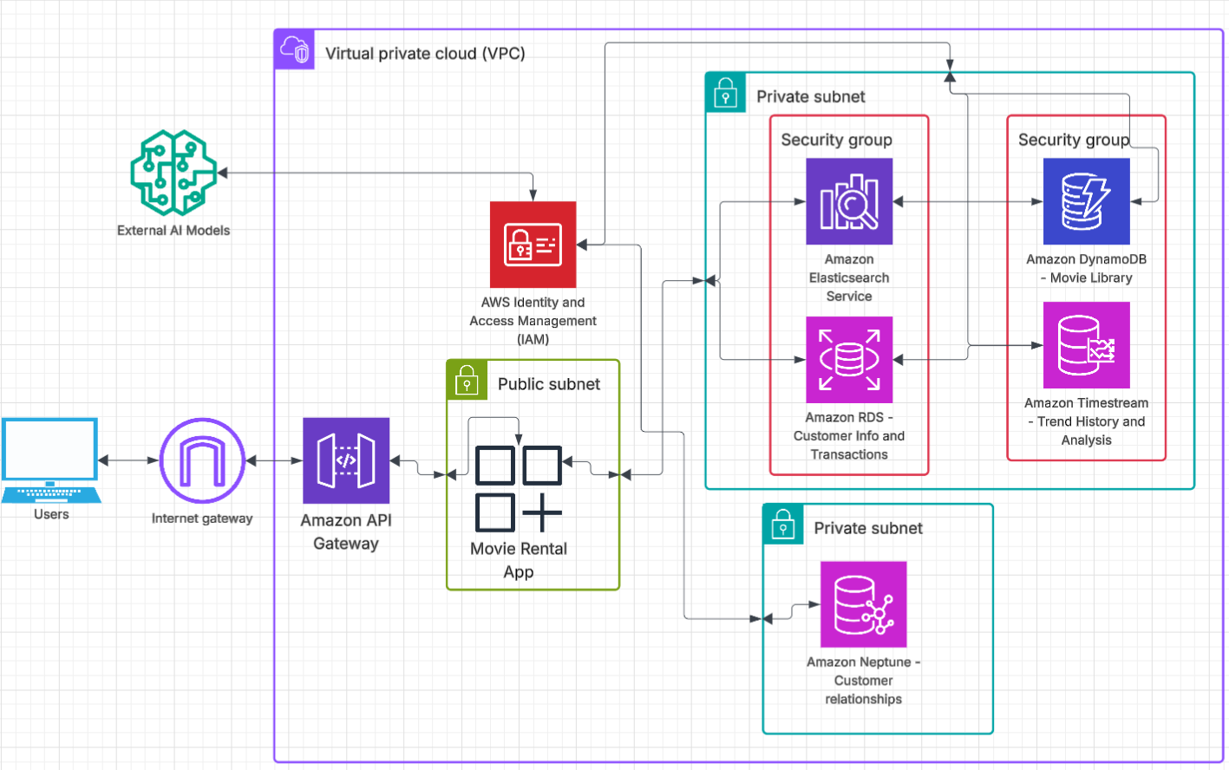
Database security
Notes:
This slide provides a visual of the ecosystem with the added security layers.

Slide 19
Administration - RDS
For our RDS, we will need to have 6 entities that should cover everything we need:
Customers, payments, invoices, rentals, reviews, and movies
Relationships
Each customer can have multiple payment methods, and each payment method is assigned to one customer.
Each customer can have multiple invoices, and each invoice is assigned to one customer.
Each customer can have multiple rentals, and each rental is assigned to one customer.
Each customer can leave multiple reviews, and each review is created by one customer.
Each review is assigned to one movie. Each movie can have multiple reviews.
Each invoice is assigned to one rental.
Each movie can be rented multiple times; each rental is assigned to a movie.
Notes:
This slide goes over the database and tables to be created in RDS.

Slide 20
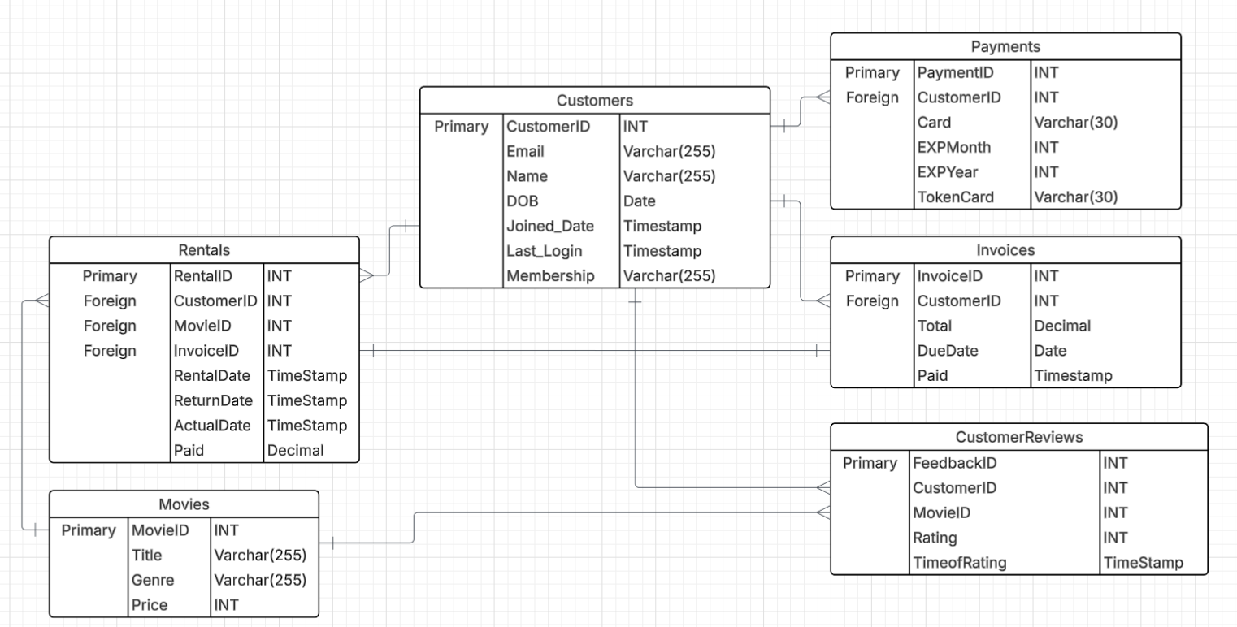
Administration - RDS
Notes:
This slide provides an ER diagram of the RDS.

Slide 21
Administration - DynamoDB
Being a nosql database a schema does not really need to be defined at the time of database creation.
We want to ensure that the data we store in the DB is what we need for quick queries.
We also need to be able to perform analytics and have AI integration.
To do this we will create a single table in DynamoDB called Movies.
It will have a partition key of MovieId and a sort key of MovieTitle.
Attributes in the table:
Director, genre, year, cast
It will have two global secondary indexes for advanced queries.
One will use year as a value and the other will use director.
(Amazon DynamoDB, n.d.)
Notes:
This slide goes over table creation in DynamoDB.

Slide 22
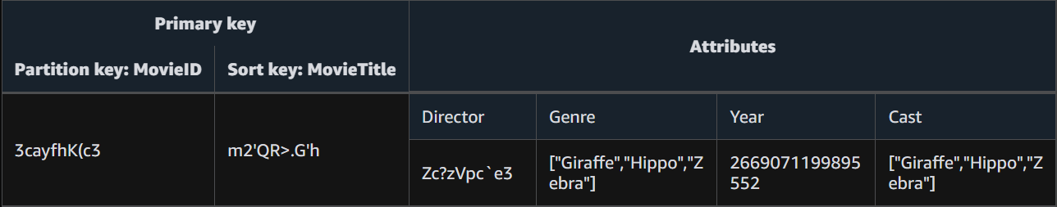
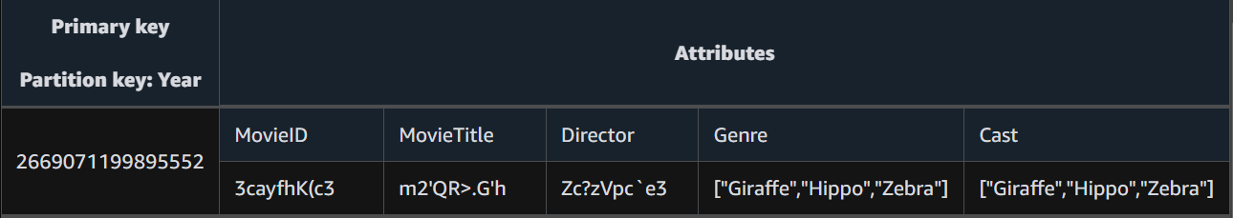
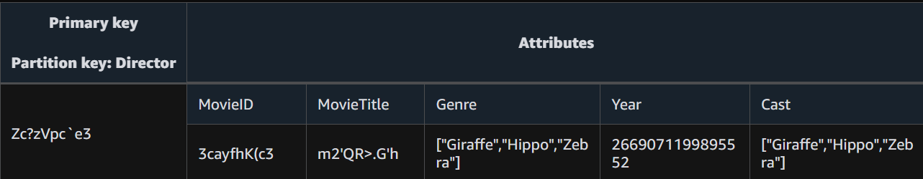
Administration - DynamoDB
Notes:
This slide provides a visual of the table in DynamoDB. It was created using the NoSQL workbench.

Slide 23
Administration - Neptune
For our graph database, we need to pull the data from the RDS and DynamoDB to model the relationships that we want to visualize.
AWS has built in integration tools to read data from those sources.
AWS DMS – data management service to automatically load data from other databases into Neptune.
Our vertices (entities) for our graph are customers, rentals, movies, and genre.
We want to see how the company’s customers interact with the movies and how often movies are being rented.
(AWS Developers, 2022)
Notes:
This slide goes over graph creation in Neptune by defining vertices and edges.

Slide 24
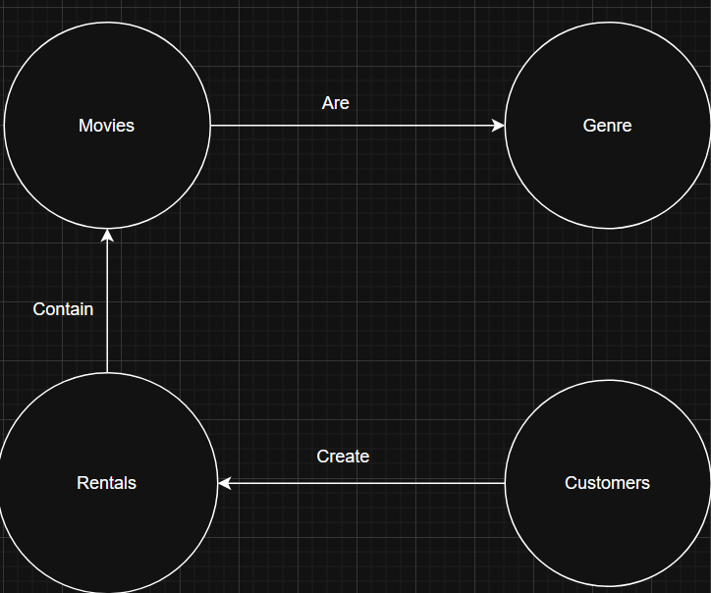
Administration - Neptune
Notes:
This slide provides a visual of the graph database at a very basic level.

Slide 25
Administration - Timestream
For our time series database, we can again use AWS DMS to migrate the data we need into Timestream.
We are going to create two timestream tables, one for customer information and one for rental information.
Rental table: RentalID, rented timestamp, time rented (Days), customerid, Customer Name, Movie Title, genre.
Customer table: CustomerID, Customer name, membership level, number of rentals, last login timestamp.
(Data Modeling Best Practices to Unlock the Value of Your Time-Series Data | AWS Database Blog, 2023)
Notes:
This slide goes over the table creation in Timestream for our temporal data.

Slide 26
AI Database Integration and Optimization

Slide 27
AI Integration
Being hosted on AWS, there are several AI tools that can be utilized to perform the automation and analysis that the company is looking for.
Automation – AWS Lambda: serverless computing tool which can be used to automatically update our database information that we need for things like inventory management.
Customer Recommendations – AWS Personalize: ML algorithm that creates recommendations based on the company data. Has integration with RDS and Neptune.
Trend and other sales forecasting – AWS Sagemaker canvas: has the ability to integrate ML models to the timestream DB to perform forecasting on time series data.
Notes:
This slide discusses the use of AWS native AI tools to further simplify our ecosystem, but still get the benefits that the company is looking for.

Slide 28
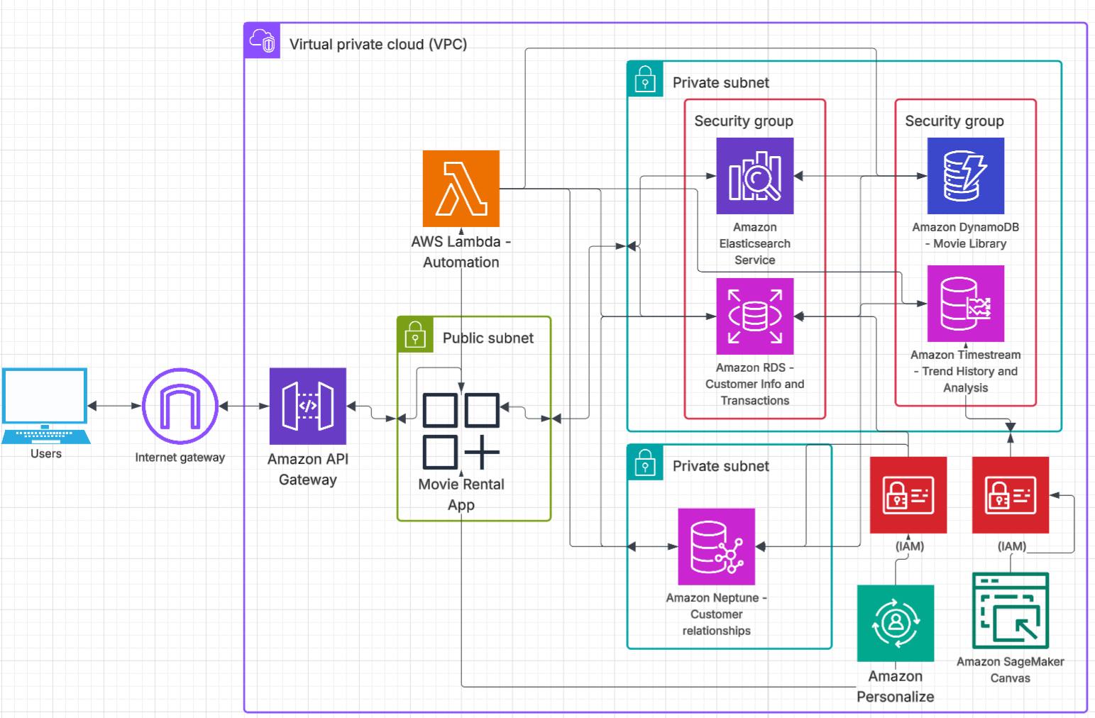
AI Integration
Notes:
This slide provides a deeper look at our ecosystem with our AI tools now being defined.

Slide 29
Basic queries - Postgre
SELECT c.customer_id, c.name, COUNT(r.rental_id) AS rental_count FROM customers c JOIN rentals r ON c.customer_id = r.customer_id GROUP BY c.customer_id ORDER BY rental_count DESC LIMIT 500;
This is a basic SQL query that can be used to grab the top 500 users of the platform.
This can be used by our ai tools to determine if there are any patterns within these users.
Notes:
This slide goes over a basic query in SQL.

Slide 30
Basic queries - DyanmoDB
response = table.query( IndexName=year', KeyConditionExpression=‘year = :year', ExpressionAttributeValues={ ‘:year’: ‘2025' } )
This is a basic query in python that can be used to grab all the movies that have the year 2025 by using the global secondary index we created.
This could be used by our ai models in conjunction with other databases to display more in-depth information about recent movies to see if any are hot or trending.
It could also represent a search that a user would do when looking for movies to rent.
Notes:
This slide goes over a basic query in DynamoDB.

Slide 31
Basic Queries - Neptune
g.V().has('Customer', 'name', 'Alice') .out('created') .out('are') .in_('are') .in_('created') .dedup().values('name') .toList()
This gets a list of customers who have rented the same movies.
It can be used by our ai tools to analyze any patterns in customers who rent the same movies, which then can power recommendations for other similar customer profiles.
Notes:
This slide goes over a basic query in Neptune.

Slide 32
Basic Queries - Timestream
SELECT Customerid, "Customer Name“, "Movie Title", “Genre”, "Time_Rented“ FROM "movie-rental-database"."Rentals“ WHERE "Rented" BETWEEN ago(30d) AND now() ORDER BY "Rented" DESC LIMIT 100;
This timestream query allows us to grab all the rentals in the last 30 days, limiting to 10o entries.
Again, this can be used for visualization and pattern recognition created by our ai models.
It also can be used to make business decisions based on historical patterns of activity.
Notes:
This slide goes over a basic query in Timestream.

Slide 33
Data Analytics and Business Intelligence

Slide 34
Data analytics - postgre
SELECT m.MovieID, m.Title, COUNT(r.RentalID) AS rentals FROM Movies m JOIN Rentals r ON m.MovieID = r.MovieID WHERE r.RentalDate >= DATE_TRUNC('month', CURRENT_DATE INTERVAL '1 month') GROUP BY m.MovieID HAVING COUNT(r.RentalID) > 30 ORDER BY rentals DESC;
This advanced query can be used for inventory analysis.
This query shows all the movies that were rented more than 30 times last month. This allows the company to adjust their inventory appropriately for what is being rented.
Notes:
This slide goes over an advanced query in SQL.

Slide 35


Data analytics - dynamodb
import boto3
from datetime import datetime, timedelta
import matplotlib.pyplot as plt
from dynamodb_json import json_util
dynamodb = boto3.resource('dynamodb')
table = dynamodb.Table('Movies') # Replace with your table name
three_months_ago = (datetime.now() - timedelta(days=90)).isoformat()
response = table.scan(
FilterExpression='added_date >= :date',
ExpressionAttributeValues={
':date': three_months_ago
}
)
movies = json_util.loads(response['Items'])
movie_titles = []
add_dates = []
genres = []
for movie in movies:
movie_titles.append(movie.get('title', 'N/A'))
add_dates.append(datetime.fromisoformat(movie['added_date']))
genres.append(', '.join(movie.get('genres', [])))
plt.figure(figsize=(12, 8))
plt.plot_date(add_dates, movie_titles, linestyle='none')
plt.title('Movies Added in Last 3 Months')
plt.ylabel('Movie Title')
plt.grid(True)
plt.xticks(rotation=45)
plt.tight_layout()
plt.show()
This code and query graphs all the movies that were added to the dynamodb database in the past three months.
This advanced visual could be used to display on the front page of the web app under a new releases banner. Because it is always querying the most recent three months, it does not need to be updated.
This code could be turned into a lambda function, so it is setup once and automated to run, freeing up DBAs to work on other queries.
Notes:
This slide goes over an advanced query in DynamoDB.

Slide 36
Data analytics - netpune
g.V().hasLabel('Genre').project('genre','rental_count').by('name').by(in_('CONTAINS').count())order().by('rental_count', decr).toList()
Here is a specific query to see which genre has the most rentals. This is important to see if there are any patterns here, so the company could add or promote more movies of the same genre.
Neptune also has visualization options, where you can see the network of relationships as a whole, which can be very helpful for easy analysis.
Notes:
This slide goes over an advanced query in Neptune.

Slide 37
Data analytics - timestream
SELECT bin("rented timestamp", 1h) AS hour_bin, COUNT(*) AS rentals FROM "movie-rental-database"."Rentals" WHERE "Rented" BETWEEN ago(90d) AND now() GROUP BY bin("Rented", 1h) ORDER BY hour_bin;
This query is more advanced, as it shows the breakdown of movie rentals per hour.
This advanced query is good for determining things like scaling policies, as you could scale up your app when you notice more users are making rentals and using the application.
Notes:
This slide goes over an advanced query in Timestream.

Slide 38
Bibliography
How to Choose The Right Database for Your Application? (2020, December 23). GeeksforGeeks. https://www.geeksforgeeks.org/how-to-choose-the-right-database-for-your-application/
Key-Value Database: How It Works, Key Features, Advantages. (n.d.). InfluxData. https://www.influxdata.com/key-value-database/
MG. (2023, April 11). Chat with Your SQL Data Using ChatGPT. YouTube. https://www.youtube.com/watch?v=1FeBkAccobY
ByteByteGo. (2022, September 20). How To Choose The Right Database? YouTube. https://www.youtube.com/watch?v=kkeFE6iRfMM
Graph database concepts - Getting Started. (n.d.). Neo4j Graph Data Platform. https://neo4j.com/docs/getting-started/appendix/graphdb-concepts/

Slide 39
Bibliography
What Is a Search-Engine Database? (n.d.). Amazon Web Services, Inc. https://aws.amazon.com/nosql/search/
Time Series Database (TSDB) Guide | InfluxDB. (n.d.). InfluxData. https://www.influxdata.com/time-series-database/
IBM. (2021, September 21). Database security. Ibm.com. https://www.ibm.com/think/topics/database-security
Core Components of Amazon DynamoDB - Amazon DynamoDB. (n.d.). Docs.aws.amazon.com. https://docs.aws.amazon.com/amazondynamodb/latest/developerguide/HowItWorks.CoreComponents.html
AWS Developers. (2022, August 17). Graph Database introduction, deep-dive and demo with Amazon Neptune - AWS Virtual Workshop. YouTube. https://www.youtube.com/watch?v=Y6jbFC8tvVw
Data Modeling Best Practices to Unlock the Value of your Time-series Data | AWS Database Blog. (2023, September 14). Aws.amazon.com. https://aws.amazon.com/blogs/database/data-modeling-best-practices-to-unlock-the-value-of-your-time-series-data/

Slide 40
Bibliography
Amazon. (2024). What is Amazon Personalize? - Amazon Personalize. Docs.aws.amazon.com. https://docs.aws.amazon.com/personalize/latest/dg/what-is-personalize.html
Time Series Forecasts in Amazon SageMaker Canvas - Amazon SageMaker AI. (2025). Amazon.com. https://docs.aws.amazon.com/sagemaker/latest/dg/canvas-time-series.html

